Slide 2
Handling asynchronicity in Javascript in 2018

Slide 3
Michel Vollebregt

Slide 4
Contents
The problem
Promises
Observables
What to use?
Notes:
There are more ways, but I’ll explain these two.
Who ever used…?

Slide 5
The problem
Your JavaScript runs in a single thread in the browser
Don’t block!
Notes:
Okay, I lied a bit: web workers run asynchronously…

Slide 6
Example: most recent repo
What is the most recent GitHub repo I pushed to?
http call
JSON

Slide 7
promises

Slide 8
Promises
const endpointUrl =
'https://api.github.com/users/mvollebregt/repos?sort=pushed’;
fetch(endpointUrl);
fetch() returns a Promise

Slide 9
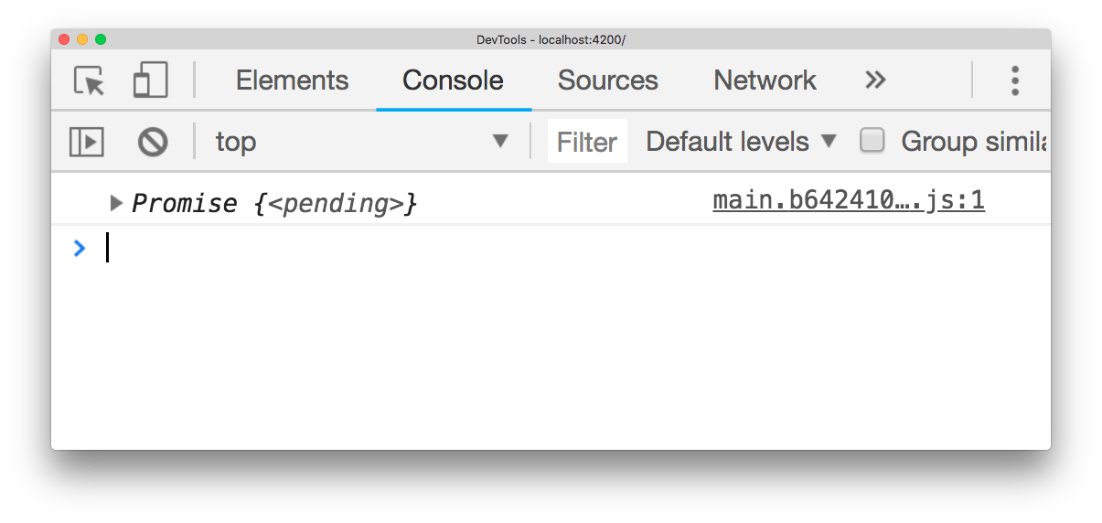
Promises
const endpointUrl =
'https://api.github.com/users/mvollebregt/repos?sort=pushed’;
fetch(endpointUrl).then(response =>
console.log(response.json())
);
result.json() returns another Promise

Slide 10
Promises
const endpointUrl =
'https://api.github.com/users/mvollebregt/repos?sort=pushed’;
fetch(endpointUrl).then(response =>
response.json()
).then(repos =>
console.log(repos[0].name)
);

Slide 11
Before we had Promises
const endpointUrl =
'https://api.github.com/users/mvollebregt/repos?sort=pushed’;
doGet(endpointUrl, response => {
parseJson(response, function (parsed) {
console.log(parsed[0].name);
});
});

Slide 12
Async / await
Notes:
Async / await is available since EcmaScript 2017

Slide 13
async / await
console.log(repos[0].name)
fetch(endpointUrl)
response.json()
Notes:
Async / await is available since EcmaScript 2017

Slide 14
async / await
const response = await
const repos = await
console.log(repos[0].name)
fetch(endpointUrl)
response.json()
Notes:
Async / await is available since EcmaScript 2017
It also works with regular try / catch.

Slide 15
async / await
function getLatestRepo() {
const response = await
const repos = await
return repos[0].name;
}
async
fetch(endpointUrl)
response.json()
Notes:
Async / await is available since EcmaScript 2017
It also works with regular try / catch.

Slide 16
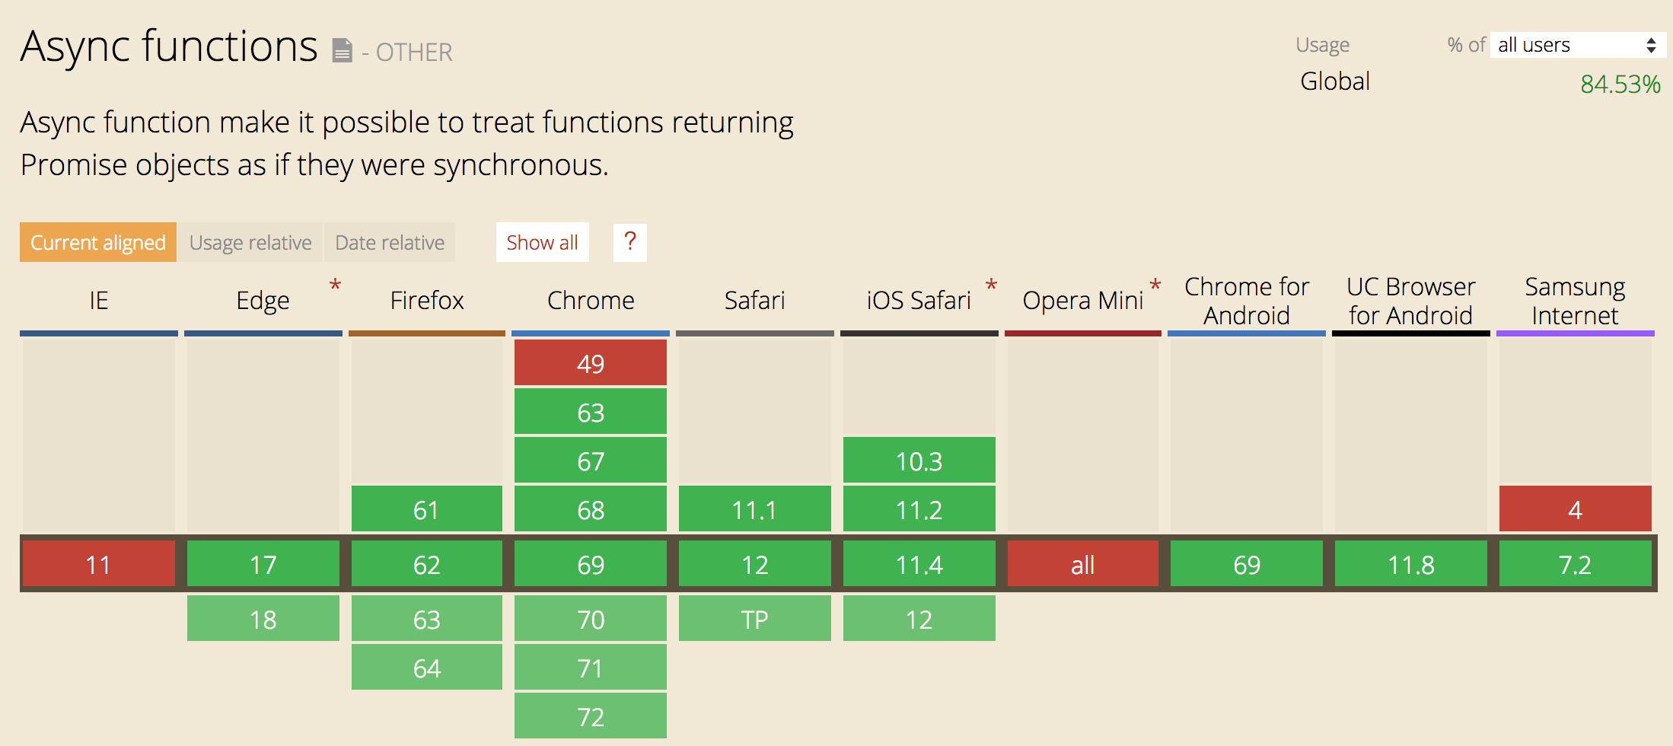
Browser support
Source: caniuse.com
It does not matter if you transpile your code!
Notes:
Async / await is available since EcmaScript 2017

Slide 17
pitfalls

Slide 18
Example: comparing repos
I have three friends.
Who did the most recent push?

Slide 19
Comparing repos
const myRepo = await getLatestRepo('mvollebregt’);
const myFriendsRepo = await getLatestRepo('ilionx’);
const myOtherFriendsRepo = await getLatestRepo('qnh’);
if (myRepo.pushed_at > myFriendsRepo.pushed_at
&& myRepo > myOtherFriendsRepo.pushed_at) {
console.log('I won!’);
}

Slide 20
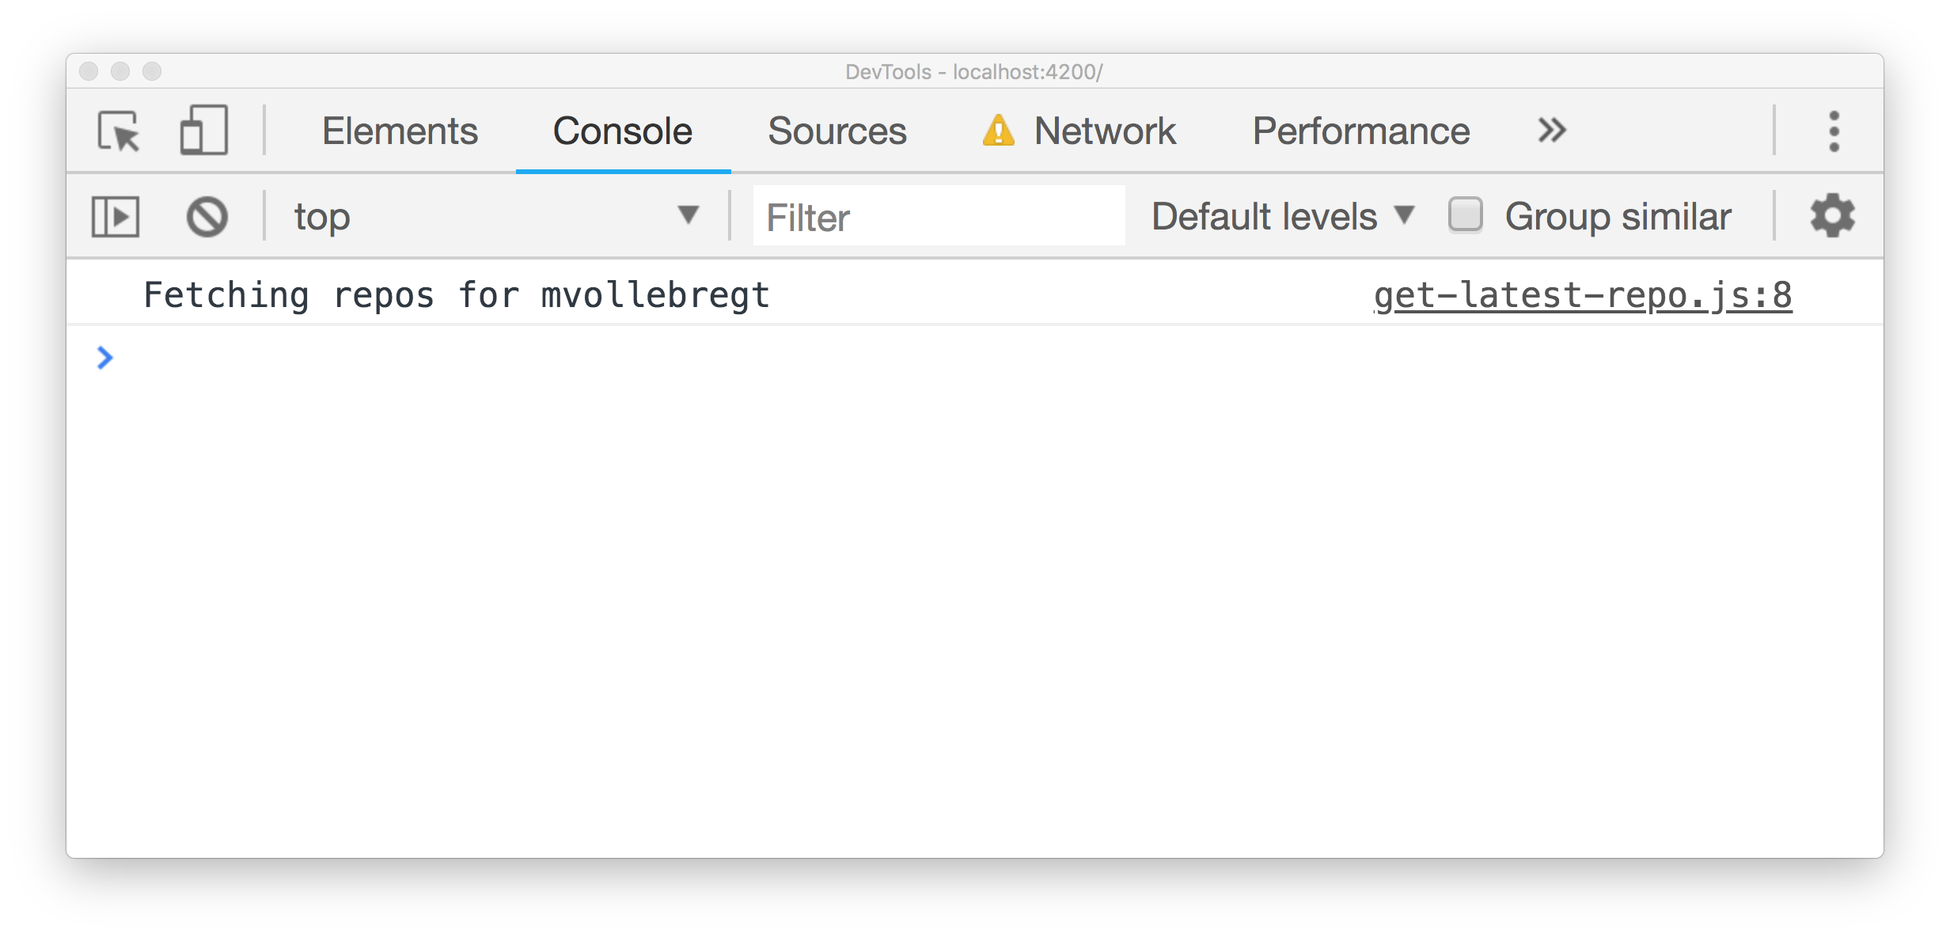
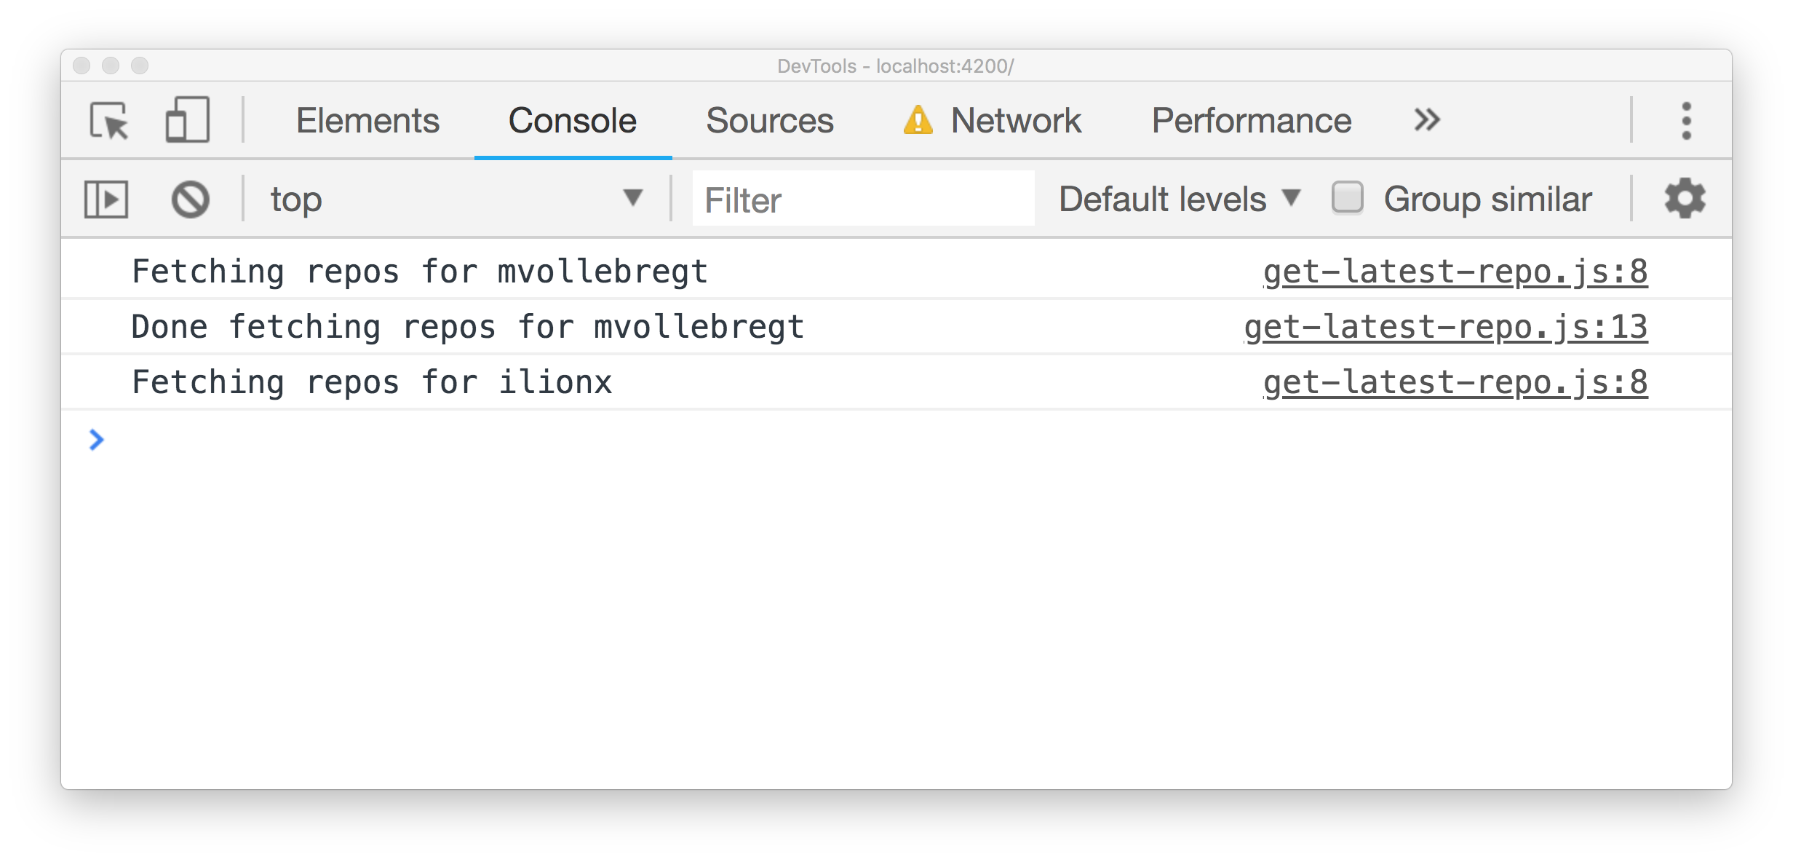
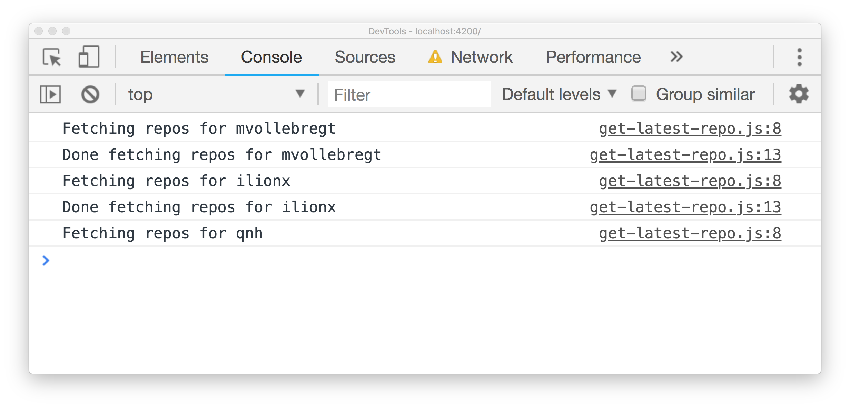
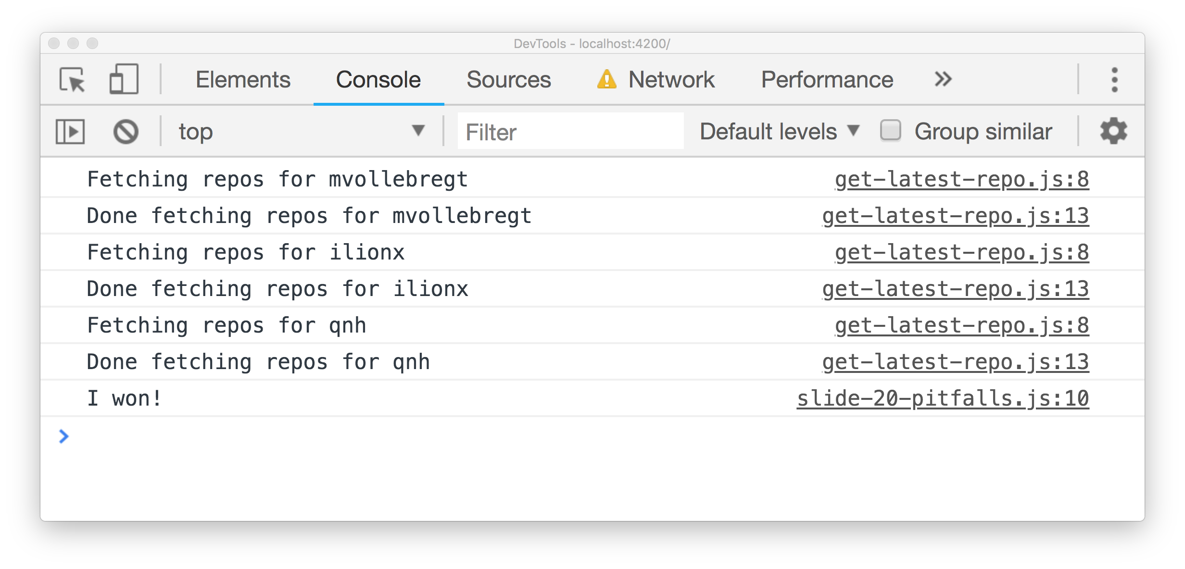
Comparing repos
const myRepo = await getLatestRepo('mvollebregt’);
const myFriendsRepo = await getLatestRepo('ilionx’);
const myOtherFriendsRepo = await getLatestRepo('qnh’);
if (myRepo.pushed_at > myFriendsRepo.pushed_at
&& myRepo > myOtherFriendsRepo.pushed_at) {
console.log('I won!’);
}

Slide 21
Promise.all to the rescue
const myRepo = await
const myFriendsRepo = await
const myOtherFriendsRepo = await
getLatestRepo('mvollebregt’),
getLatestRepo('ilionx’),
getLatestRepo('qnh')

Slide 22
Promise.all to the rescue
getLatestRepo('mvollebregt’),
getLatestRepo('ilionx’),
getLatestRepo('qnh')

Slide 23
Promise.all to the rescue
await Promise.all([
]);
getLatestRepo('mvollebregt’),
getLatestRepo('ilionx’),
getLatestRepo('qnh')

Slide 24
Promise.all to the rescue
const [myRepo, myFriendsRepo, myOtherFriendsRepo] =
await Promise.all([
]);
getLatestRepo('mvollebregt’),
getLatestRepo('ilionx’),
getLatestRepo('qnh')

Slide 25
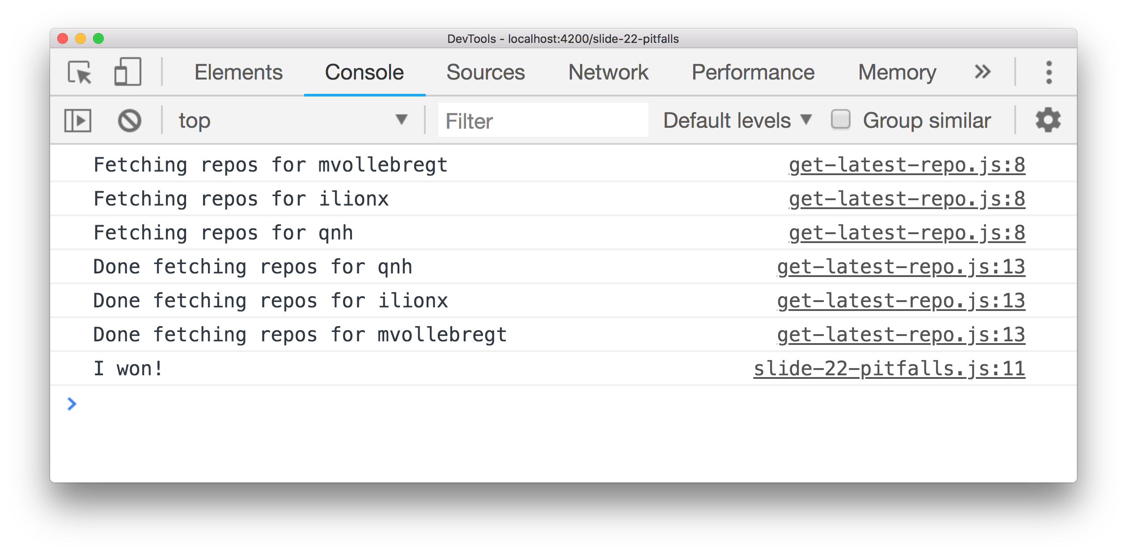
Promise.all to the rescue
const [myRepo, myFriendsRepo, myOtherFriendsRepo] =
await Promise.all([
]);
getLatestRepo('mvollebregt’),
getLatestRepo('ilionx’),
getLatestRepo('qnh')

Slide 26
Recap: async /await
Syntactic sugar for Promises
Built into JavaScript
Imperative coding style
Easy to read code
Emit one value
Notes:
Try catch also works!

Slide 27
Bonus
Works with normal try /catch
Works with anything that implements then, not just Promises

Slide 28
observables

Slide 29
Observables
Promises on steroids
Observable emits stream of values over time
Manipulate and combine with operators
Provided by library RxJS
Angular
Notes:
For example: http response, user events, data changes, state change, all other kinds of events

Slide 30
Observables: examples
Http response
User events
Data changes
State changes
All other kinds of events

Slide 31
Example: http
httpClient.get(endpointUrl)
httpClient returns an Observable

Slide 32
Example: http
httpClient.get(endpointUrl).subscribe(
);

Slide 33
Example: http
httpClient.get(endpointUrl).subscribe(repos =>
console.log(repos[0].name)
);

Slide 34
Example: multiple values
timer(0, 1000)
emits a value every second

Slide 35
Example: multiple values
timer(0, 1000).subscribe(value => console.log(value))

Slide 36
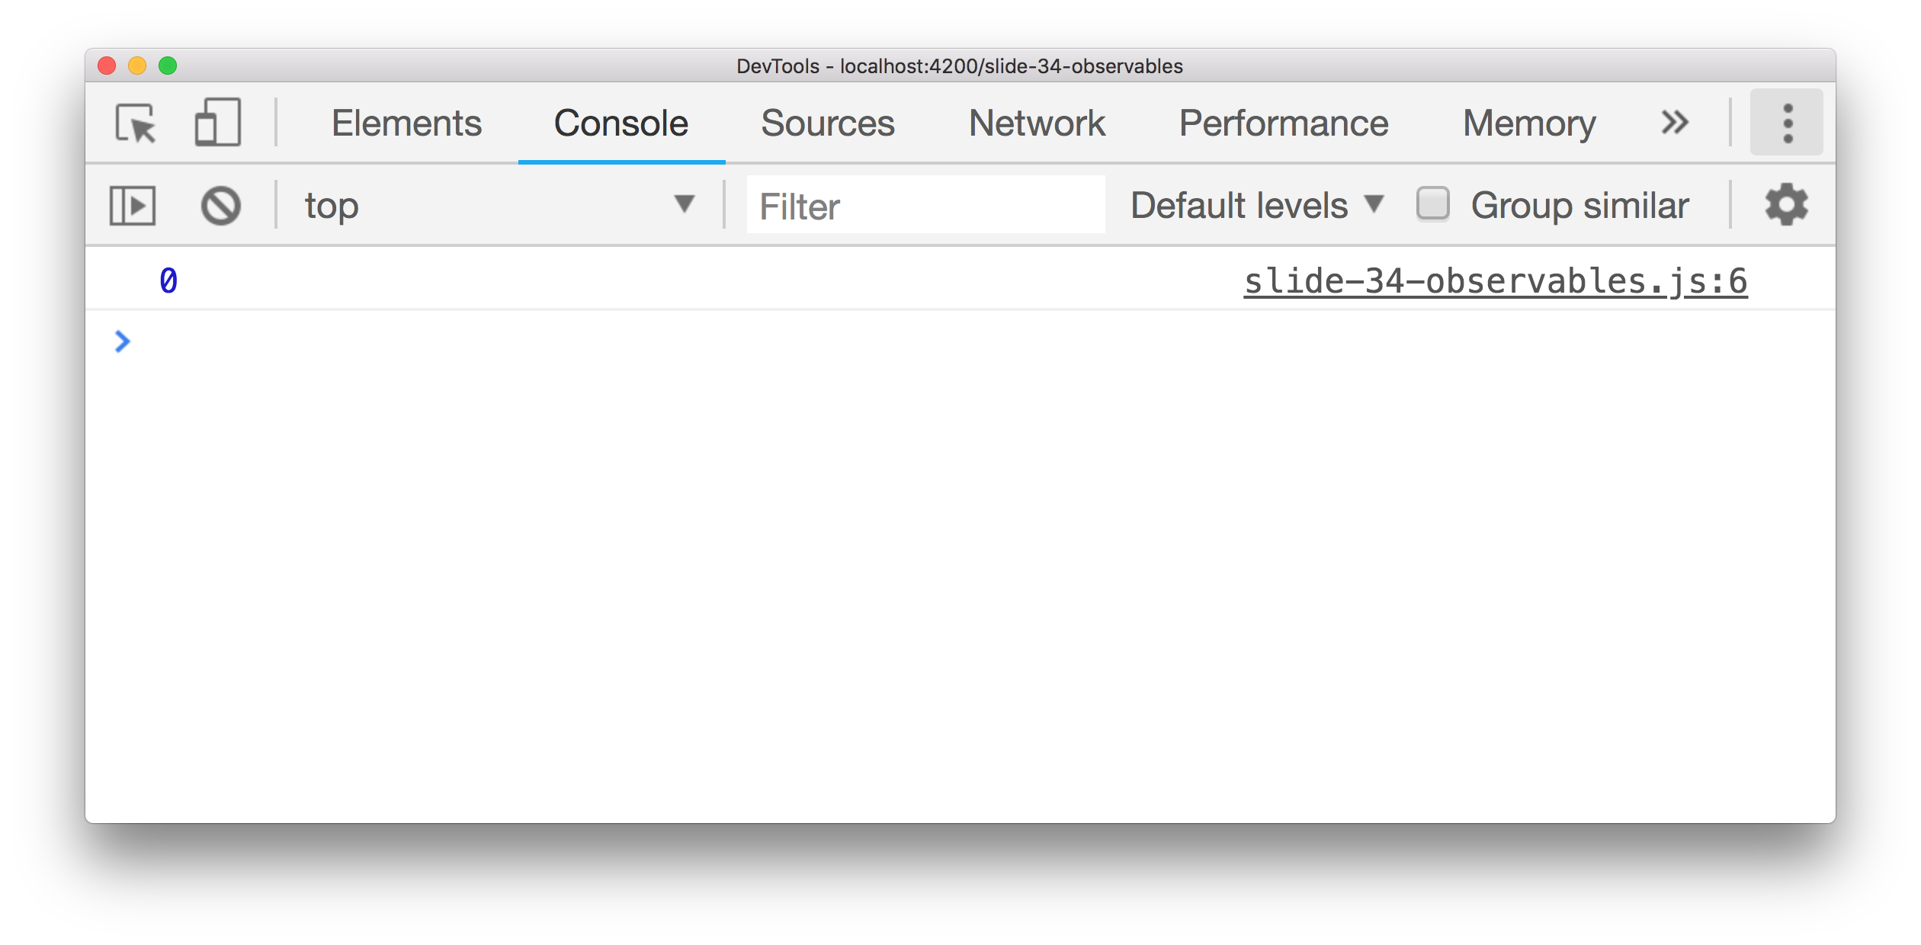
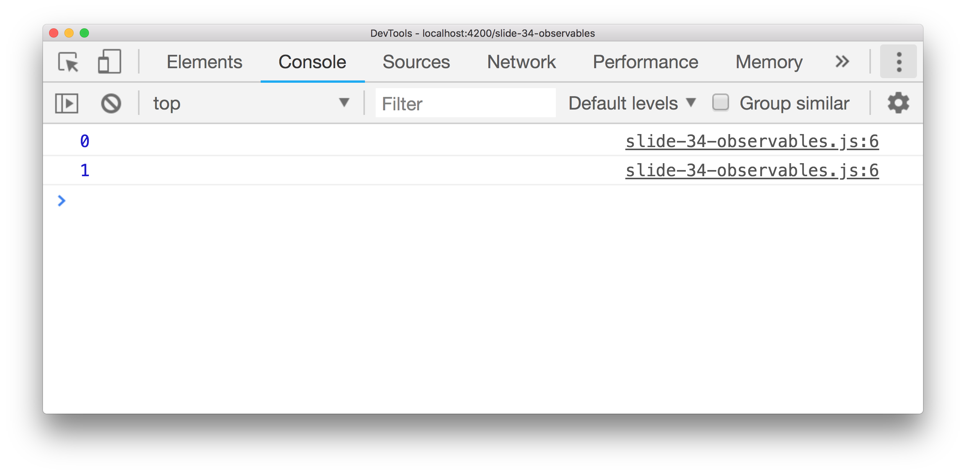
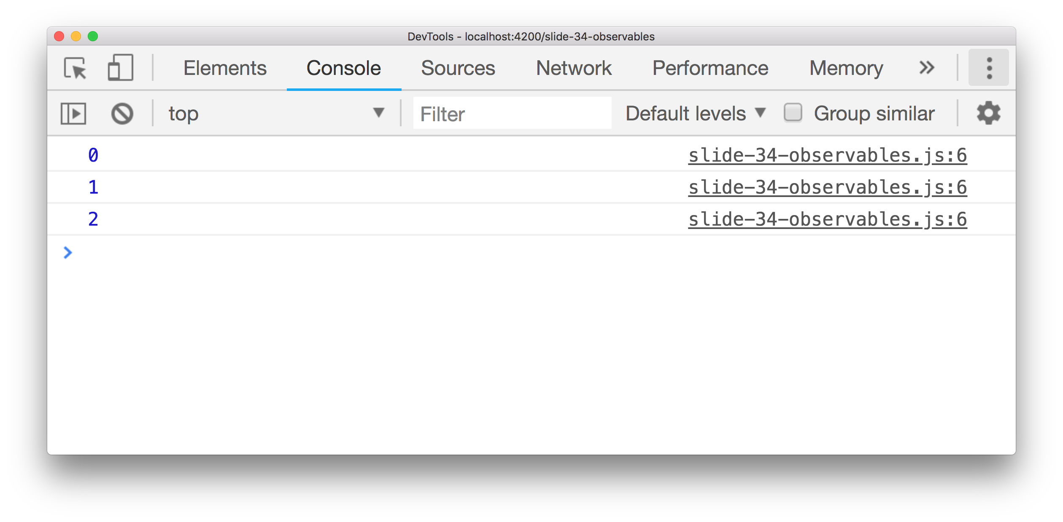
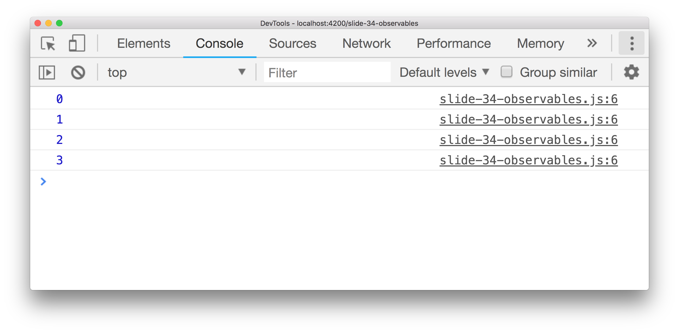
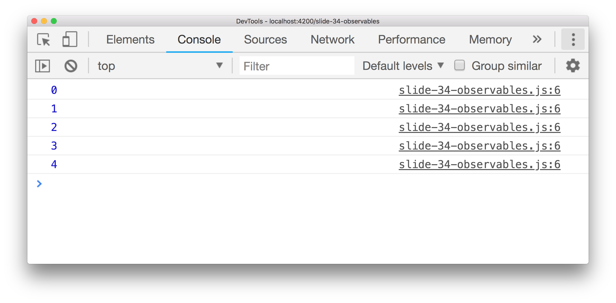
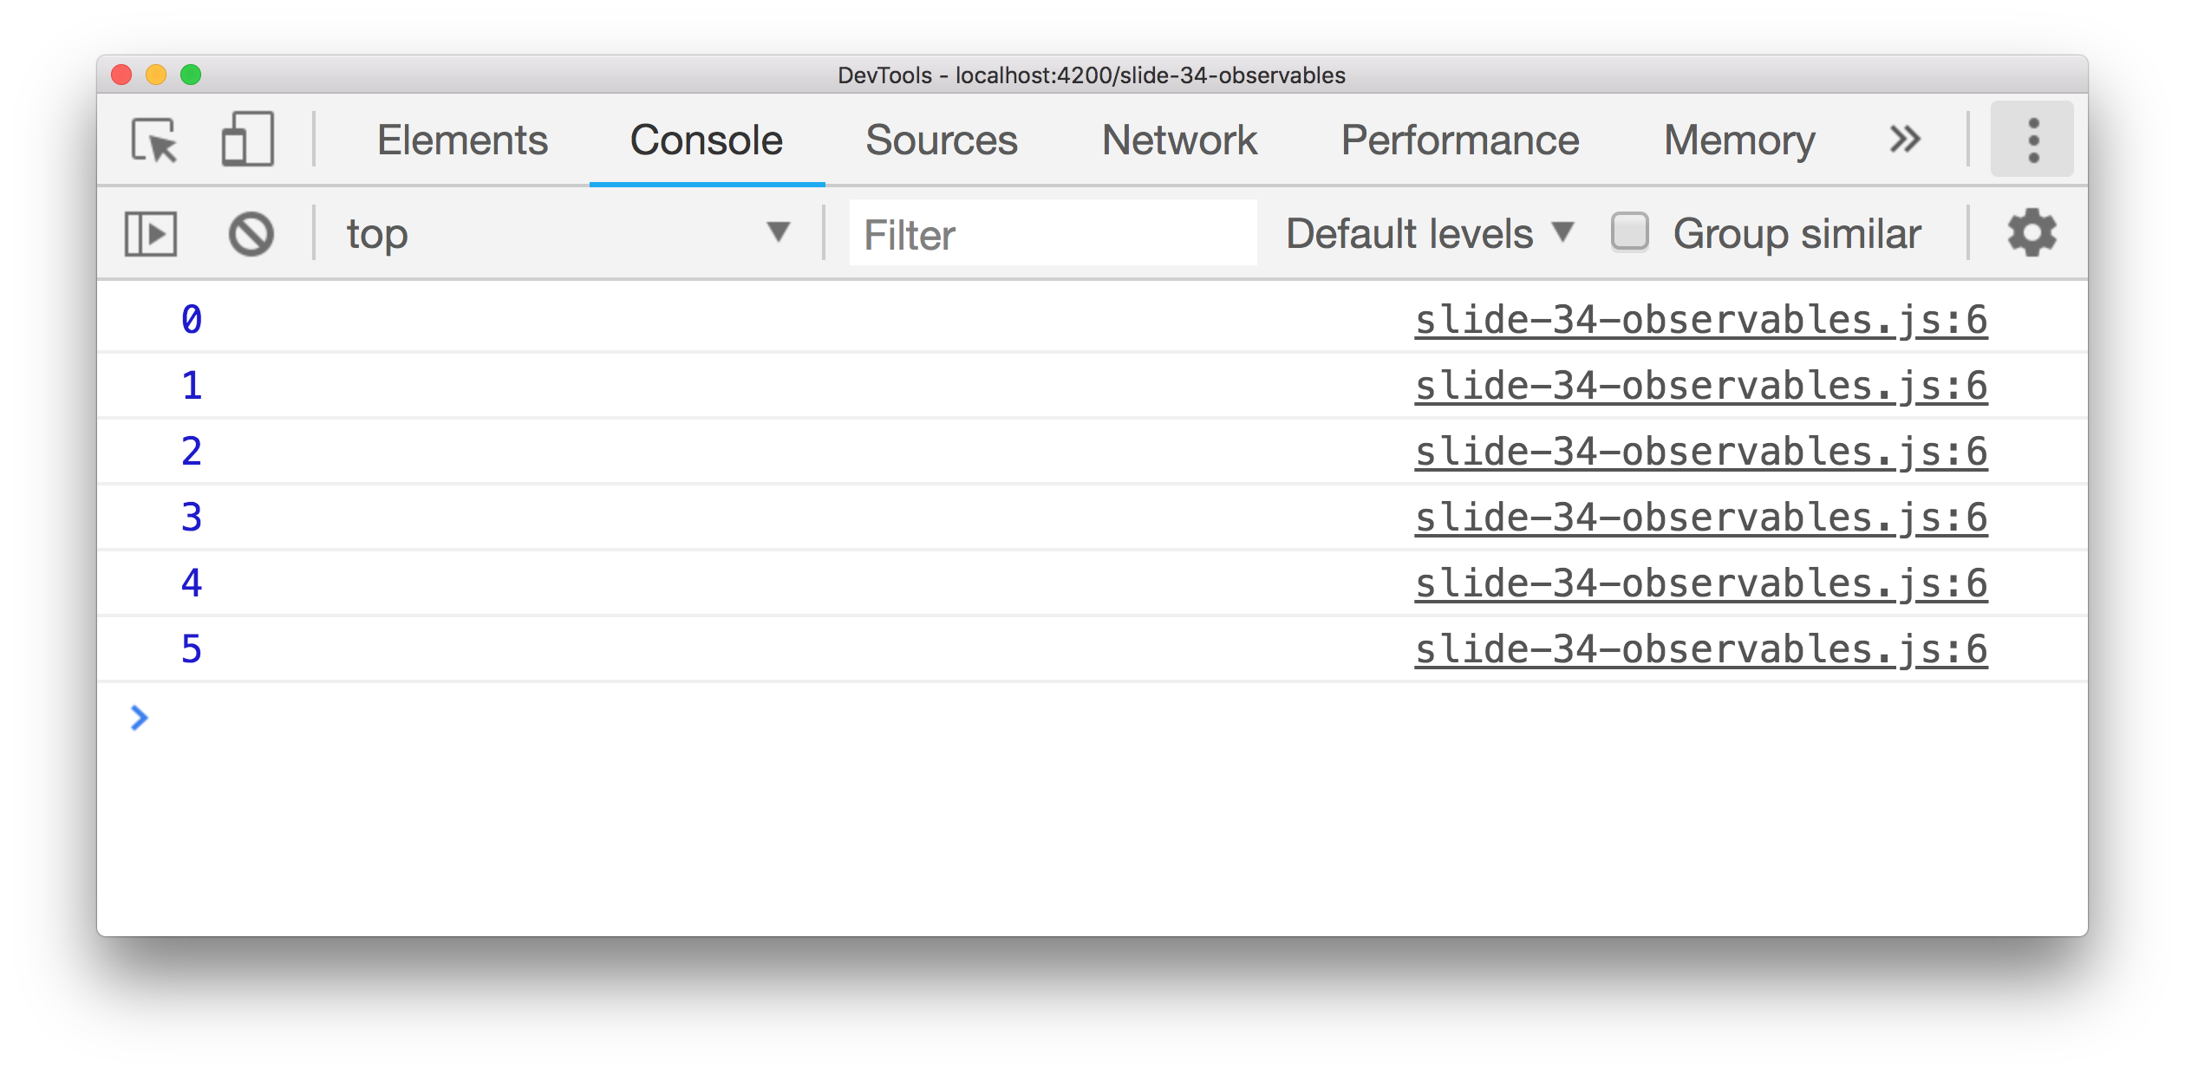
Example: multiple values
timer(0, 1000).subscribe(value => console.log(value))
Don’t forget to unsubscribe!

Slide 37
Observable
Something that emits events
Emit a value
Stop emitting values
End in error state
Observable
next(value)
complete()
error(err)
Notes:
Subscribe takes exactly these three parameters!

Slide 38
Observable
Emit a value
1
2
3
5

Slide 39
Observable
Emit a value
Stop emitting values
1
2
3
5

Slide 40
operators

Slide 41
Operators: map
1
2
3
5
map( x => 10 * x )
10
20
30
50

Slide 42
Operators: map
httpClient.get(endpointUrl)

Slide 43
Operators: map
httpClient.get(endpointUrl).pipe(
)

Slide 44
Operators: map
httpClient.get(endpointUrl).pipe(
map(repos => repos[0].name)
)

Slide 45
Operators: map
httpClient.get(endpointUrl).pipe(
map(repos => repos[0].name)
).subscribe(name =>
console.log(name)
);

Slide 46
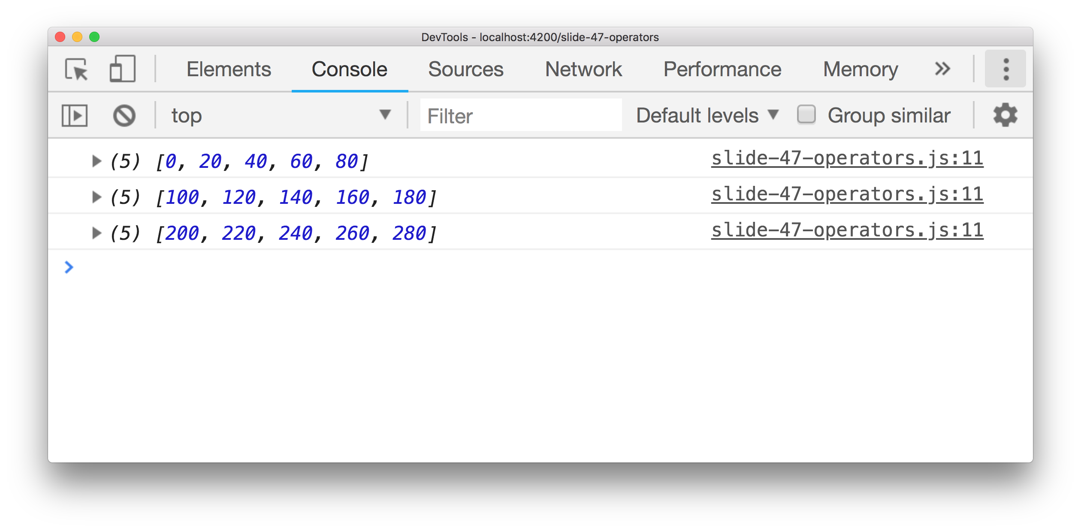
More operators
timer(0, 100).pipe(
map(x => 10 * x),
filter(x => x % 20 === 0),
bufferCount(5),
take(3),
delay(1000),
tap(x => console.log(x)) ,
catchError(() => Observable.of([]))
).subscribe();

Slide 47
Example: number of commits
Find the most recent GitHub repo I pushed to.
How many commits does it have?
Notes:
Note: I need two successive http calls

Slide 48
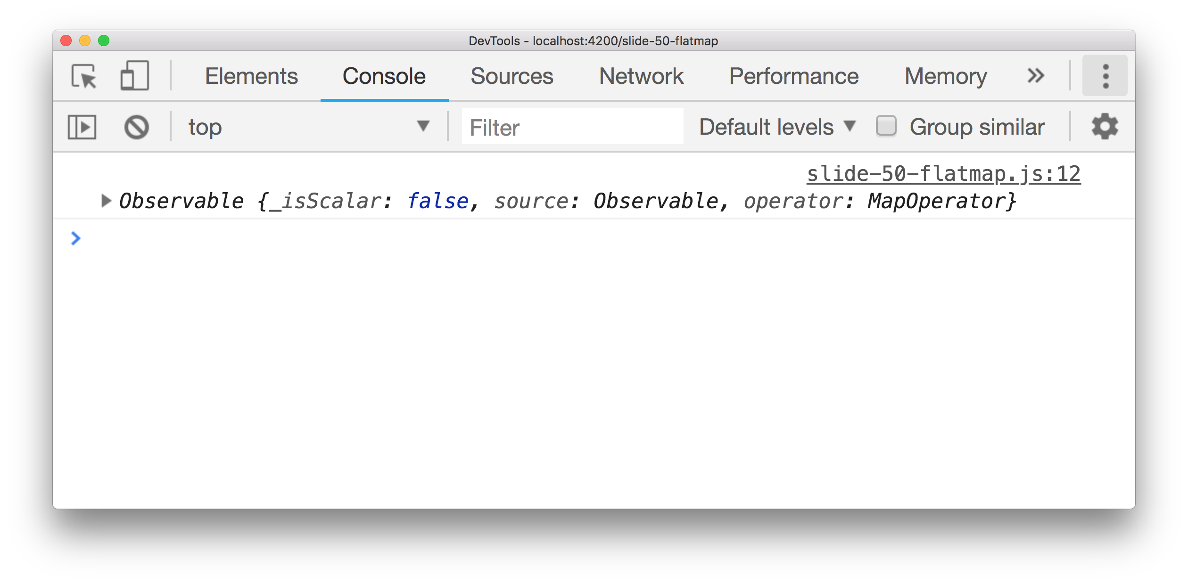
Operators: mergeMap
{
repo: 'abc'
url: 'xyz'
}
map(repo => httpClient.get(repo.commits_url))

Slide 49
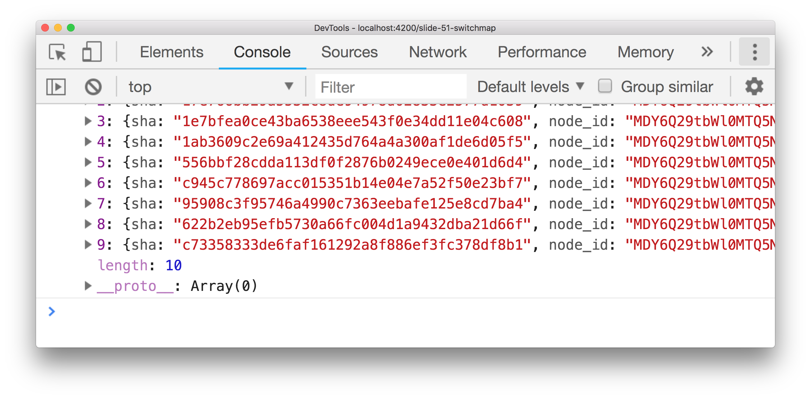
Operators: mergeMap
{
repo: 'abc'
url: 'xyz'
}
map mergeMap
[..commits]

Slide 50
Five operators like mergeMap
flatMap
mergeMap
concatMap
switchMap
exhaustMap

Slide 51
Four operators like mergeMap
mergeMap
concatMap
switchMap
exhaustMap
Source emits one value? Same effect!

Slide 52
Example: refresh on mouse click
Source observable => mouse clicks
On click => refresh data

Slide 53
Operators: mergeMap
click
click
mergeMap( http.get )
result
result
result
result

Slide 54
Preserve the order: concatMap
click
click
concatMap( http.get )
result
result
result
result

Slide 55
Cancel earlier requests: switchMap
click
click
switchMap( http.get )
result
result

Slide 56
Ignore later results: exhaustMap
click
click
click
exhaustMap( http.get )
result
result
result
result

Slide 57
Hot and cold observables

Slide 58
Hot Observable: already running
Observable
1
2
3
5
subscribe
3
5

Slide 59
Cold Observable: triggered by subscribe
Observable
subscribe
subscribe
1
1

Slide 60
Turning cold into hot: share operator
Observable
share
subscribe
subscribe
subscribe
1
1

Slide 61
Caching the values: shareReplay operator
Observable
shareReplay
subscribe
subscribe
subscribe
1
1

Slide 62
Should i use promises or observables?

Slide 63
You don’t have to choose!

Slide 64
You don’t have to choose!
Observable.from
.toPromise()
Notes:
toPromise() waits until the observable completes, then emits its LAST value

Slide 65
You don’t have to choose!
Observable.from(getLatestRepo())
.subscribe(repo => console.log(repo.name));
httpClient.get(endpointUrl).toPromise()
.then(repo => console.log(repo[0].name));
Notes:
toPromise() waits until the observable completes, then emits its LAST value

Slide 66
Should i use promises or observables?

Slide 67
Promises
Observables
Syntactic sugar async / await
Built into JavaScript
Imperative coding style
Easy to read code
Emit one value
Provided by RxJS
Functional coding style
Emit zero to infinite values
Powerful operators
Standard in Angular

Slide 68
Questions?
Michel Vollebregt
github.com/mvollebregt/techorama-2018
mvollebregt@ilionx.com
ilionx&qnh @ P2 (opposite catering)

